Slide 1
嫦娥 Chang’e
Aidan McDougal

Slide 2
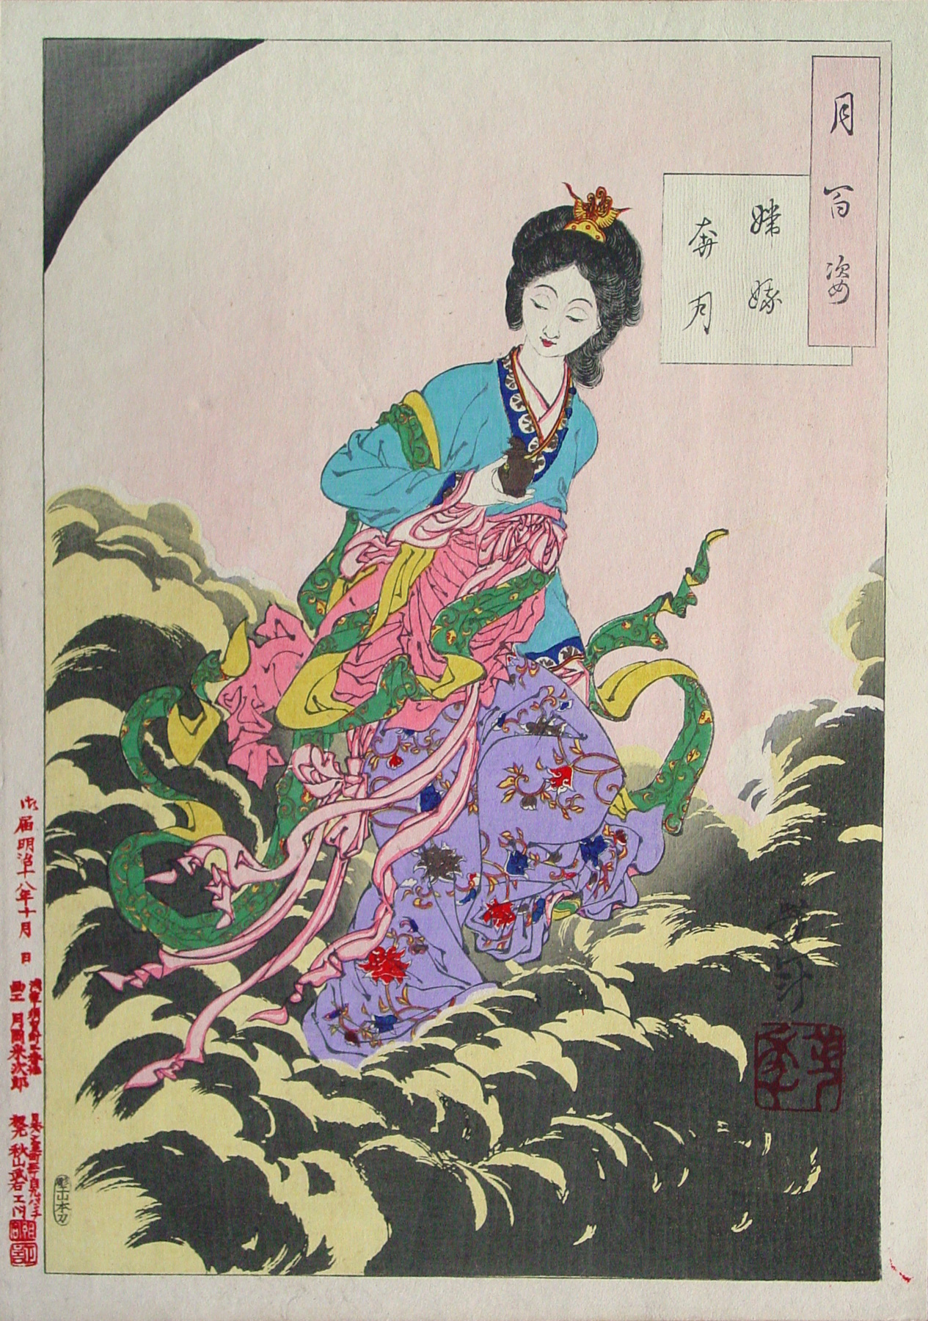
Origin
Said to have originated during the Warring States Period
Originally known as Heng’e
Name change due to a Han emperor with the same name
More fleshed-out versions of the story popularized during the Han Dynasty

Slide 3
The Myth
Chang’e is an immortal who resides on the moon
Flew there after taking an elixir of immortality that belonged to Hou Yi
How Chang’e ended up with the elixir is highly debated
Some say she took it because Hou Yi was on a dangerous power trip
Others say she took it under duress; she was home alone and confronted by burglars
She is regarded overall as smart, kind, and selfless

Slide 4
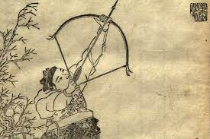
Hou Yi 后裔
Chang’e’s husband
Shot down nine of the ten blazing suns, ending the severe drought
Regarded as a hero because of this
Gifted the elixir of immortality by the Jade Emperor as a reward
Said to have become a king following these events
Some stories portray him as a benevolent ruler
Others say he became tyrannical and power hungry
Was completely devastated when Chang’e flew up to the moon & placed offerings for her

Slide 5
Jade Rabbit & Other Lunar Inhabitants
Sometimes believed to have appeared on the moon prior to Chang’e
Was originally accompanied by a toad, sometimes said to be Chang’e herself, turned ugly as punishment for stealing the elixir
The toad eventually phased out of newer stories
Joined also by Wu Gang, who was exiled to the moon as punishment, according to a story from the Tang Dynasty
Also present was a cassia tree said to produce the seeds used to make the elixir

Slide 6
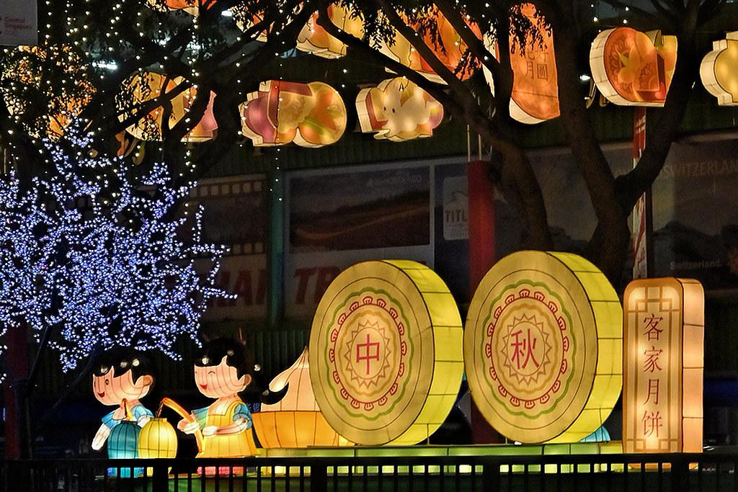
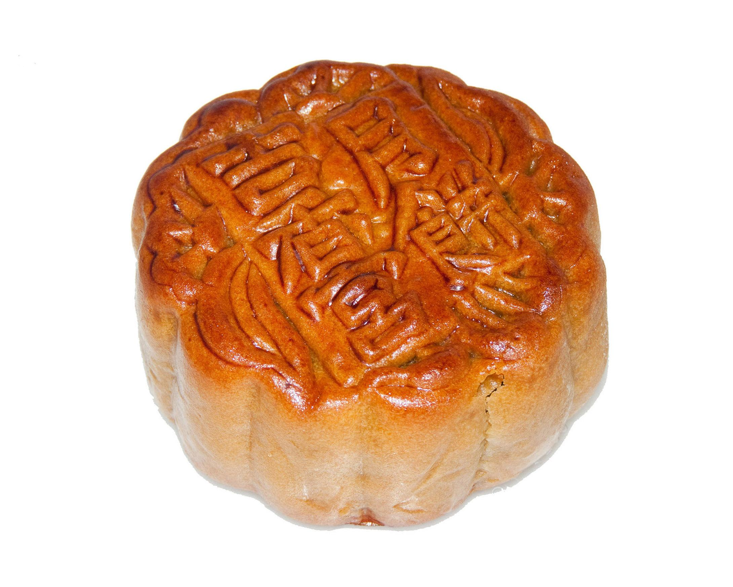
Mid-Autumn Festival 中秋节
Celebrated on the 15th day of the 8th lunar month (Sep. 17, 2024)
Full moon harvest celebrations date back to the Shang dynasty
Popularity grew until it became a full-fledged festival during the Tang dynasty
Centers around worship of the moon, gratitude for the harvest, & family reunions
Consumption of mooncakes & lighting of lanterns

Slide 7
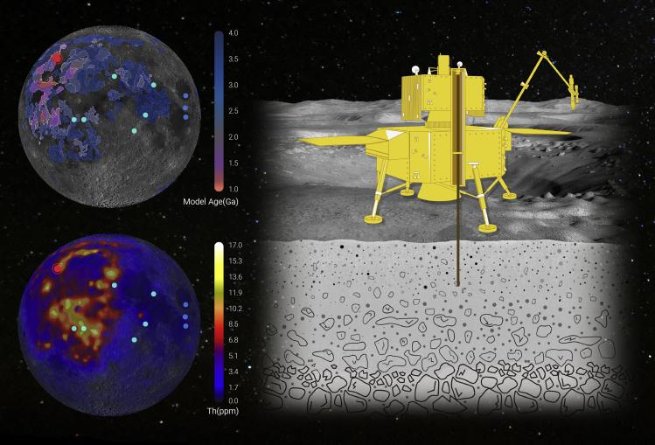
China National Space Administration (CNSA)
Founded in 1993
Launch facilities in Gansu, Shanxi, and Sichuan provinces
HQ in Beijing
China’s lunar exploration vehicles are named in honor of Chang’e
Chang’e 1-5
Chang’e 6 scheduled for 2024
Chang’e 7 & 8 slated for launches in the late 2020’s

Slide 8
Works Cited
Britannica, The Editors of Encyclopaedia. "Hou Yi". Encyclopedia Britannica, 1 Jul. 2019, https://www.britannica.com/topic/Hou-Yi. Accessed 13 March 2024.
Besha, Patrick. “Policy Making in China’s Space Program: A History and Analysis of the Chang’e Lunar Orbiter Project.” Space Policy, vol. 26, no. 4, 2010, pp. 214–21, https://doi.org/10.1016/j.spacepol.2010.08.005.
Castrillón, Samuel Botero. "Mid-Autumn Festival." Online Journal Mundo Asia Pacifico 10.19 (2021): 133-134.
"Chang'e, Chinese Goddess of the Moon | Origin, Mythology & Role." Study.com, 5 February 2023, study.com/academy/lesson/chang-e-chinese-goddess-moon-origin-mythology-role.html
Lemei, Yang. "China's Mid-Autumn Day." Journal of Folklore Research, vol. 43 no. 3, 2006, p. 263-270. Project MUSE muse.jhu.edu/article/209124.
Logsdon, John M.. "China National Space Administration". Encyclopedia Britannica, 18 March 2024, https://www.britannica.com/topic/China-National-Space-Administration. Accessed 14 March 2024.
Castrillón, Samuel Botero. "Mid-Autumn Festival." Online Journal Mundo Asia Pacifico 10.19 (2021): 133-134.
Yang W, Lin Y. New Lunar Samples Returned by Chang'e-5: Opportunities for New Discoveries and International Collaboration. Innovation (Camb). 2020 Dec 17.
Yoshitoshi’s One Hundred Aspects of the Moon, John Stevenson, Hotei Publishing, Netherlands 2001, pl. 2.

